Slide 1
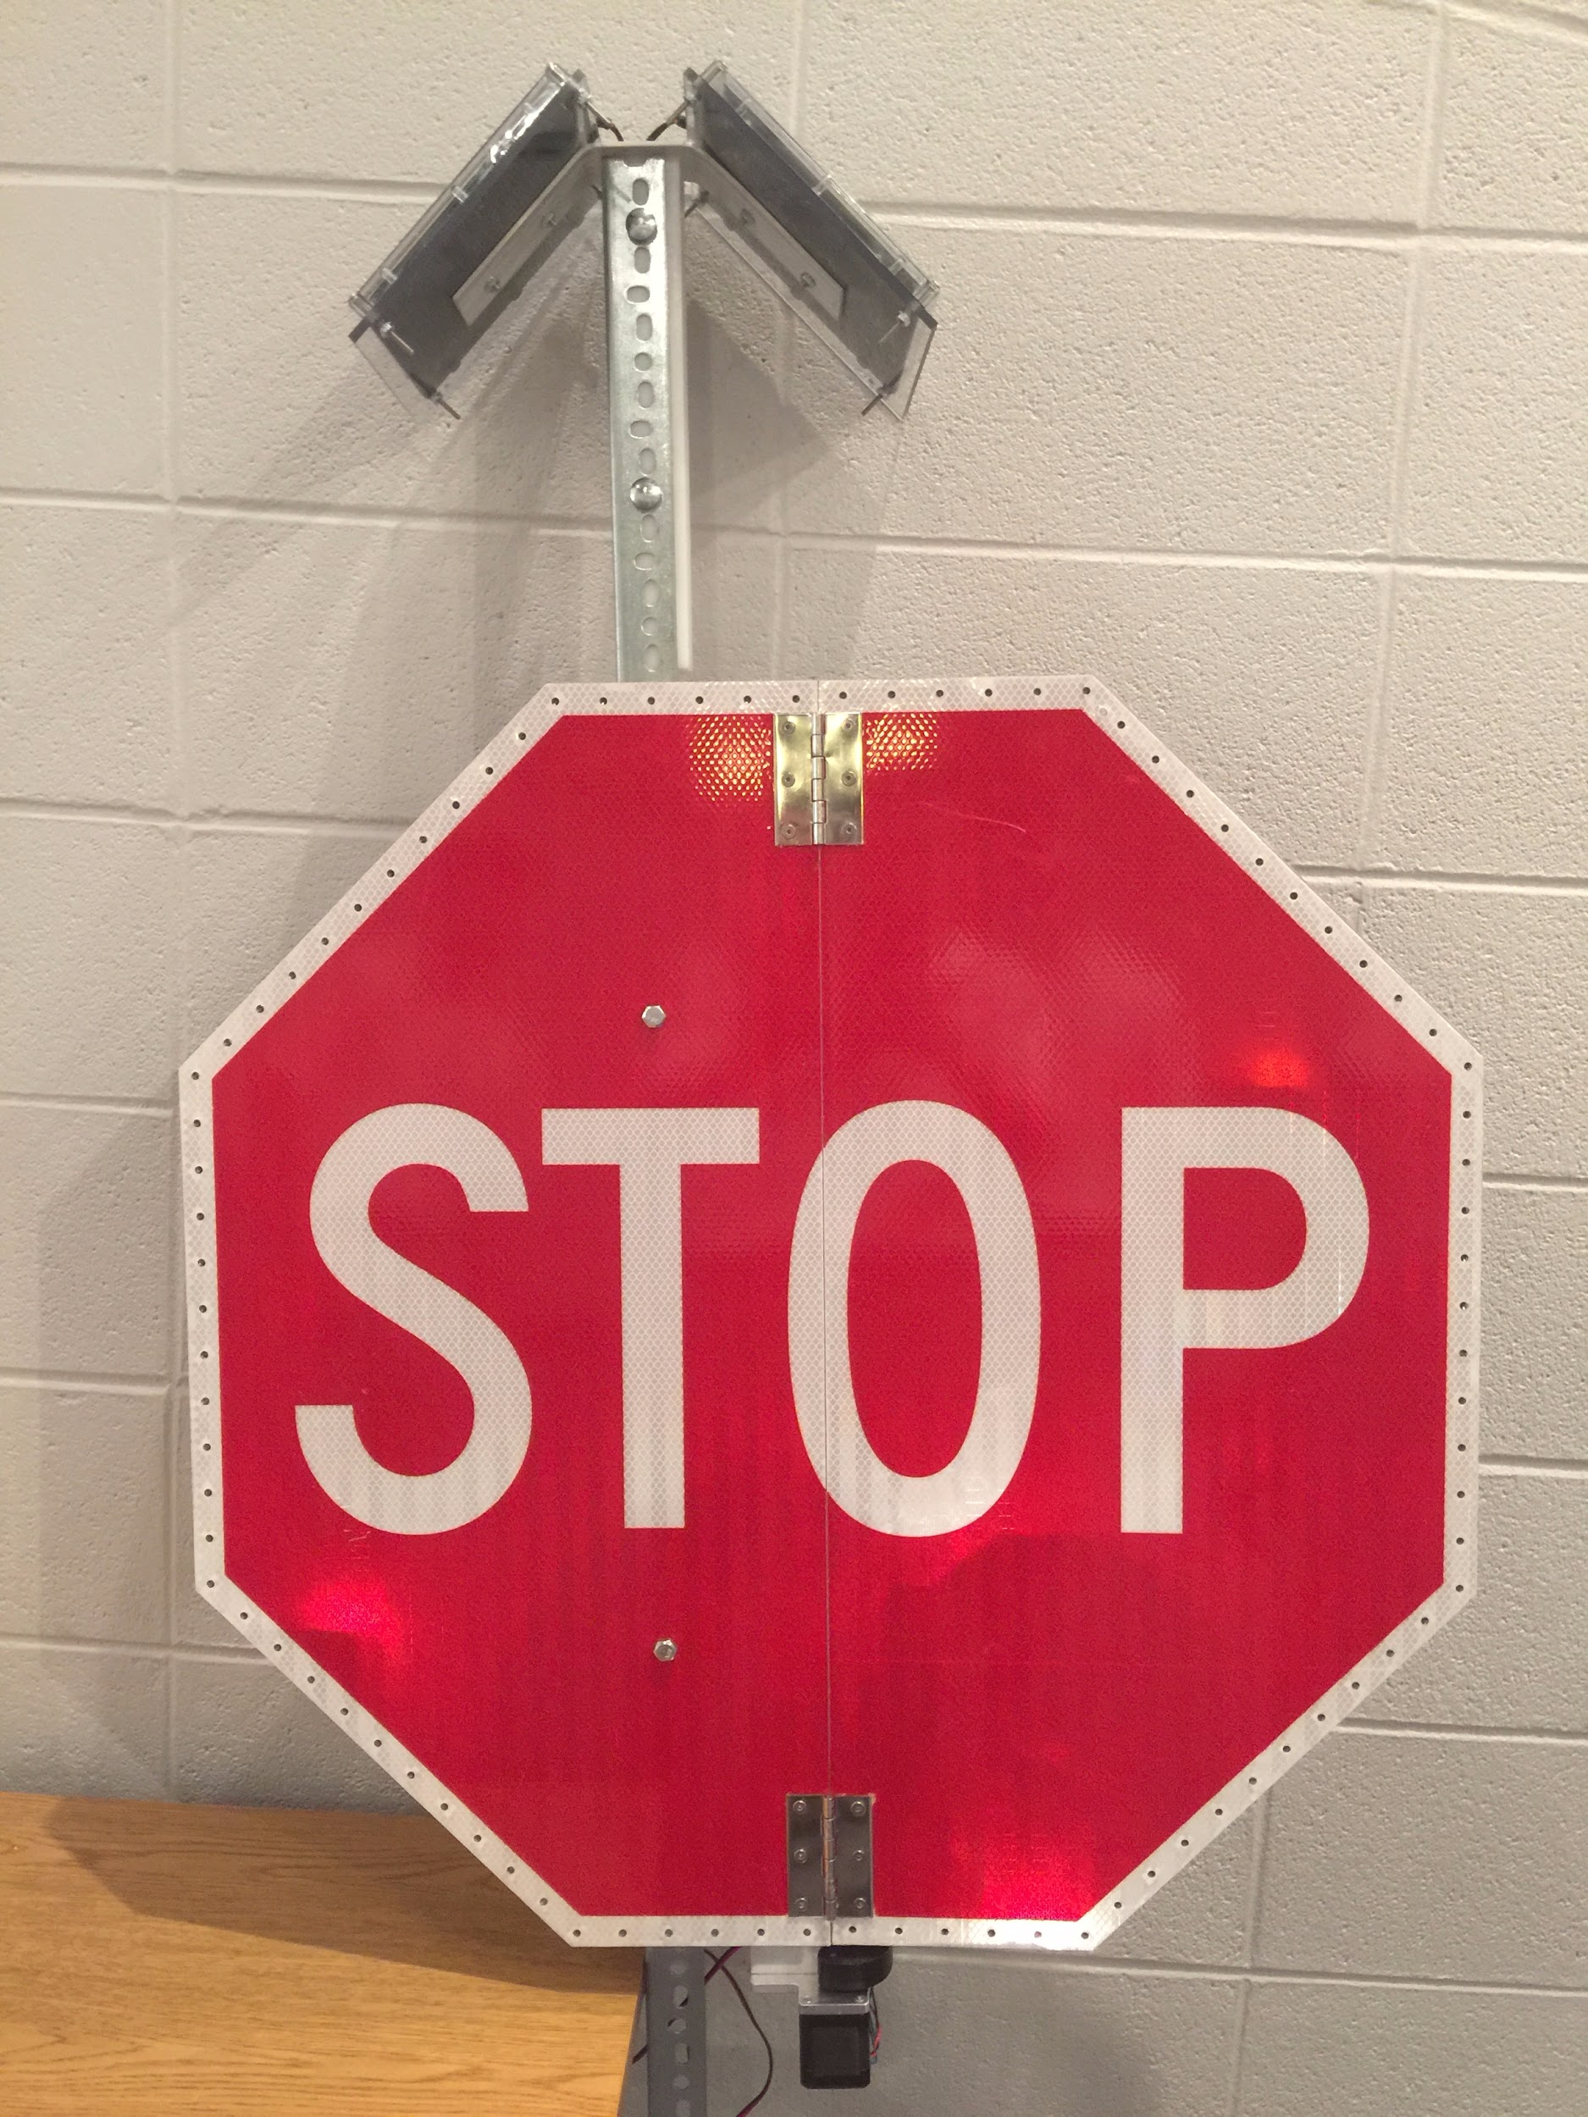

Brilliantly Bright Solar LED Street Signs Utilizing STEM Skills to Make Roads Safer
Bishop Shanahan High School 2015 STEM Team
Stephen Anderson, Angela Herb, Matthew Horger, Andrew Johnson, and Conor Waldt
Advisor: John Janasik, PhD

Slide 2
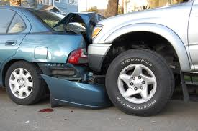
Pennsylvania Crash Statistics
2012 - $1,164 economic loss to each Pennsylvania resident.
Only dropped approximately $100 in 2013.
27,356 out of the 124,092 crashes in 2012 were rear-end collisions both at stop signs and traffic lights.
66,034 of the 124,092 crashes occurred from October to February.
16% of the crashes resulted from darkness with no streetlights or lit signs.

Slide 3
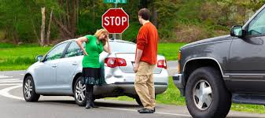
Addressing a Real World Problem
Accidents, accidents, and more accidents!!
Stop signs
Rolling Stops and Sudden Stops
Solar powered LED lights
Solar power - conserves energy
LED lights - increase visibility via light (lumens)
Folding signs
Used at traffic light intersections
Motorized opening and closing via bluetooth connection

Slide 4
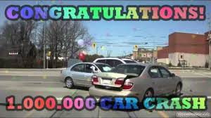
Addressing Community Needs
Reducing crash probabilities
Reducing damage to property
Saving automobile users’ lives
Increasing safety of pedestrian population
In total, 1,310 innocent lives were taken as a result of a car crash in 2012.
These crashes account for $8,198,793,104 in compensation and economic loss.
Taken from the
Pennsylvania Bureau of Highway Safety

Slide 5

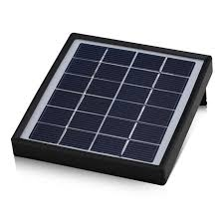
The Effect of Light & Solar Power
Light - stimulates alertness, cognition, and wakefulness in humans
Especially effective in the winter
Solar Power - Cost-effective, reliable and environmentally safe power source
Efficient/low maintenance
Applicable to road signs
Separate from the electrical grid

Slide 6
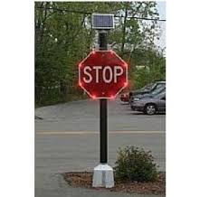
Precedent
LED signs - in use and effective.
Previous studies:
Safety and reaction times are increased by light-enhanced signs.
LED Stop Signs positively affect driver behavior and ability.
LED Stop Signs = greater visibility distance for drivers.
Current signs: costly and impractical for municipal use.
Notes:
A study on safety effects of LEDs embedded in STOP signs, conducted by the Texas Transportation Institute in 2004, found:
A 28.9 percent reduction in the number of vehicles not fully stopping; and
A 52.9 percent reduction in the number of vehicles moving through the intersection without significantly slowing.
A similar study, conducted by the Virginia Transportation Research Council in 2007, found:
A statistically significant decrease in vehicle approach speeds ranging from 1.9 to 3.4 miles per hour (mph) with an average of 2.7 mph (7% decrease) indicated that LED STOP signs positively affected driver behavior.

Slide 7
Influence on Project
Caln Township - increased implementation of folding signs
Used elsewhere across the state
Rarely opened - unrealized benefit
Recent brutal winters - power outages - dangerous conditions

Slide 8
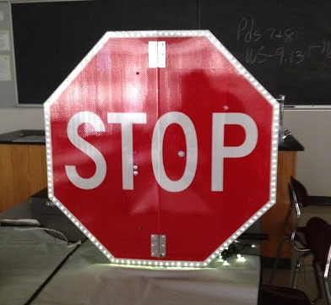
Our Sign (Version 1.0)
The Design
30” H x 30” W High Intensity Folding Vertical Stop Sign
108 ct. Solar Powered LED Lights with Attached Solar Panel (6V)
6’ Signage Pole
Nuts / Bolts / Bracers
Hot Glue & Duct Tape
1 Bucket w/ Sand
Implementation
Winter Storms
Power Outages at Intersections
Night Usage

Slide 9
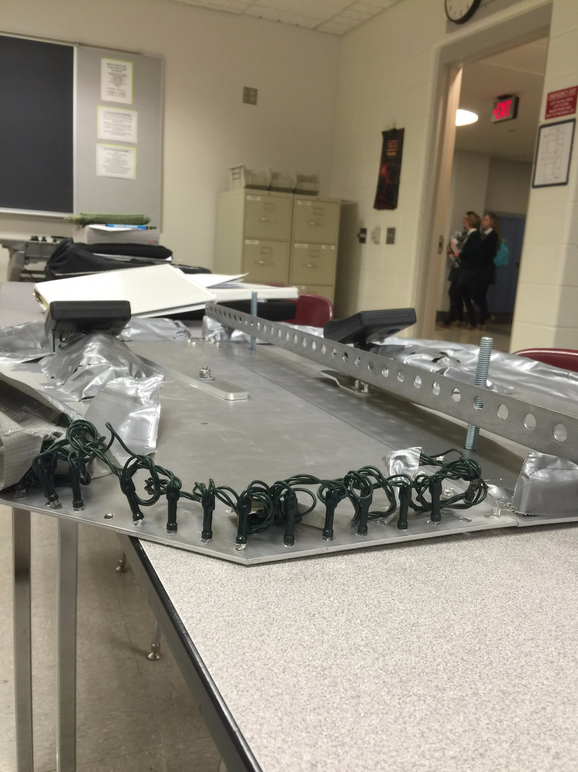
Vision for Improvement
Successes of Version 1.0
Daylight Sensor Solar Panels
Teamwork - Multitasking and Specialization
Consistent Measurements and Spacing
Shortcomings of Version 1.0
Not self-opening
Not secure
Not stable

Slide 10
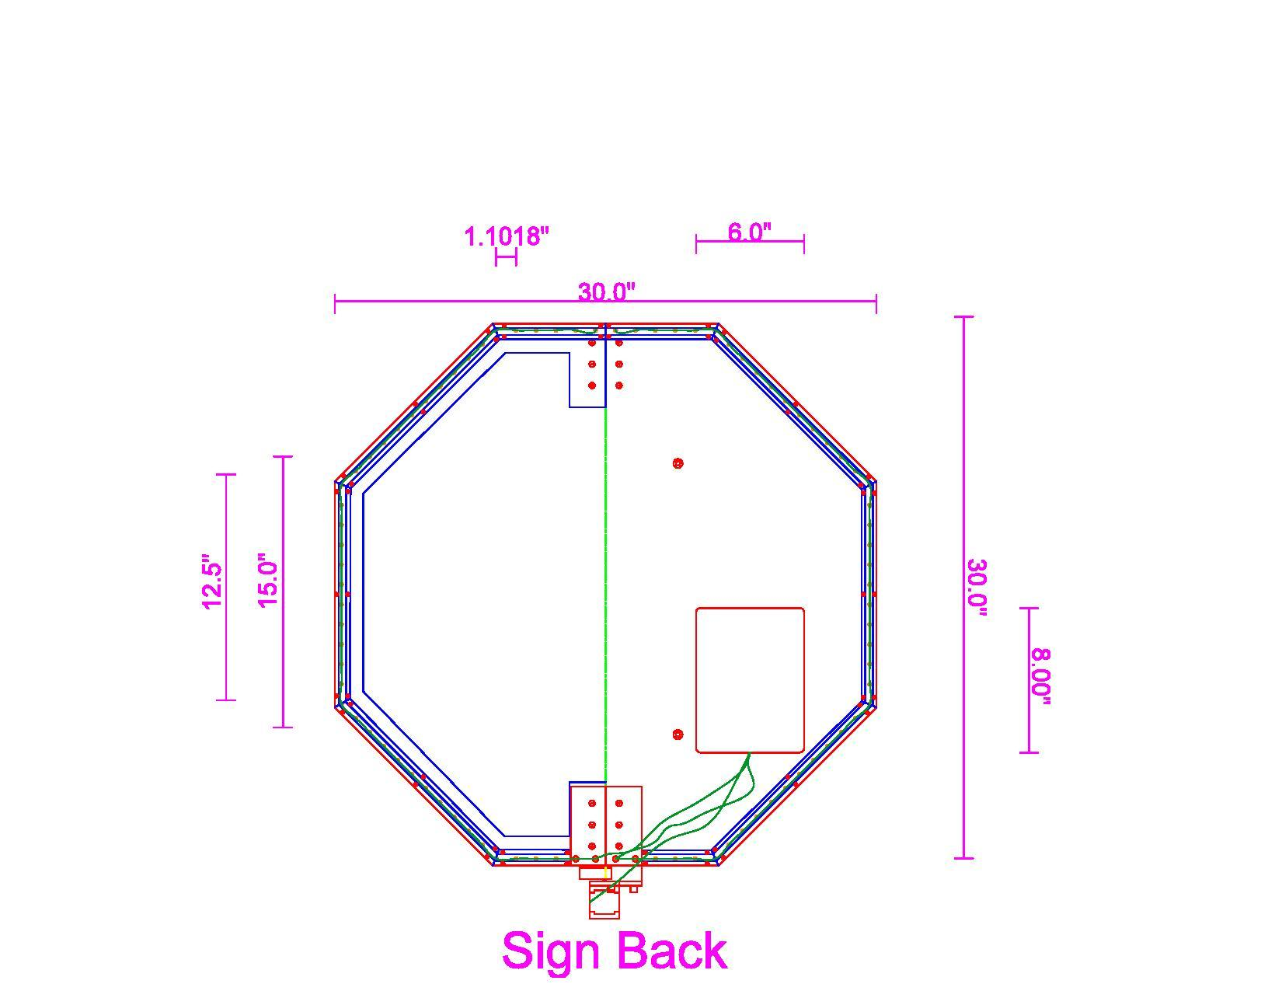
The New and Improved (Version 2.0)
The Design
30” H x 30” W High Intensity Folding Vertical Stop Sign
(2) 50 ct. White LED String Lights
1.1018” apart; 12 lights per side
(2) 12V Solar Panel
Arduino Uno w/ NEMA-17 Motor
Dual H-Bridge Motor Driver
(2) 12v AA Solar Rechargeable Battery Source
Polycarbonate Casing/Electronics Box
6’ Pole
Nuts/Bolts/Wires

Slide 11
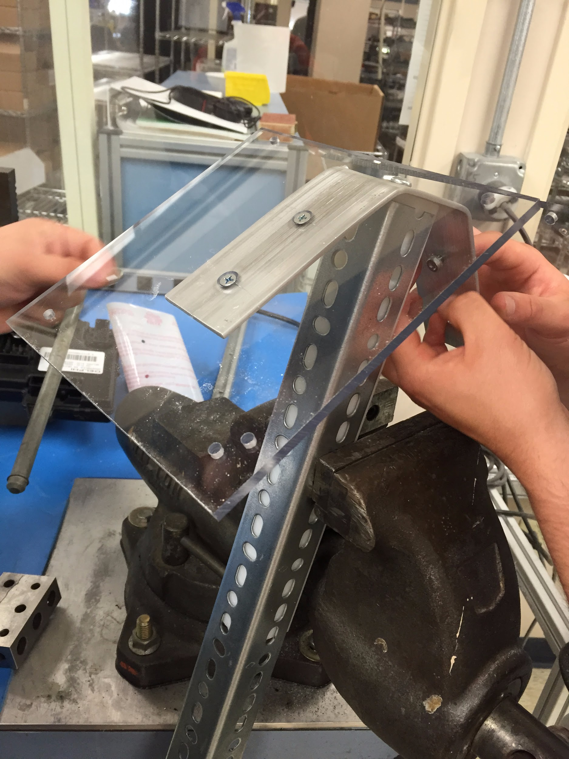
The Build
Core Elements Remain
Increased Solar Power
(2) 12V panels
Solar Mount
Casing
Durability - (Weather Proof)
Security
Precision - Mass Production

Slide 12
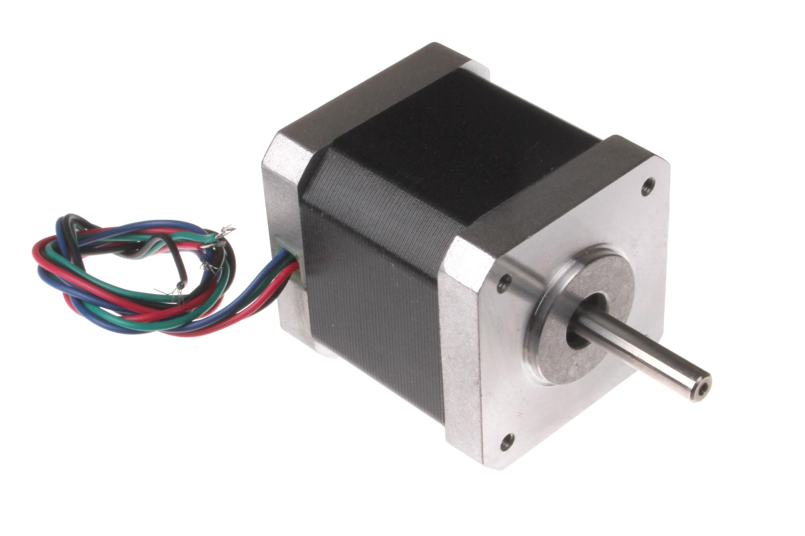
Greatest Challenge
Motorized Folding Mechanism
Electrical Circuit
Arduino
Bluetooth Signaling
Entire Intersection
Mechanical System
Nema-17 Motor
Arm/Motor Mount
Solar Power Distribution

Slide 13
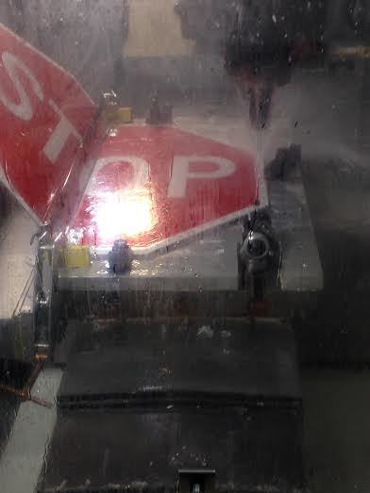
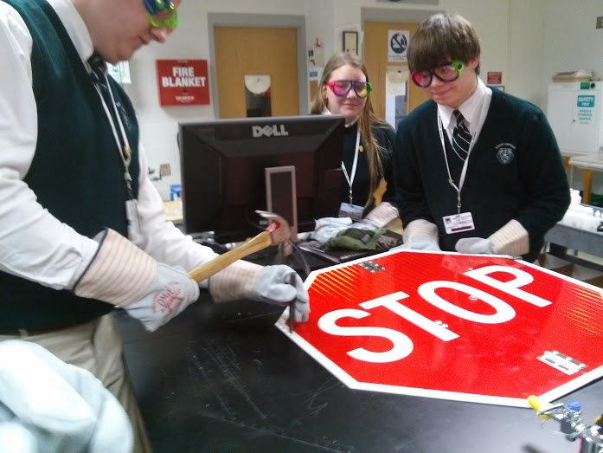
The building of the state competition sign demonstrated improvement in building techniques to work towards a product that can be mass produced.
Regional Build
State Build

Slide 14
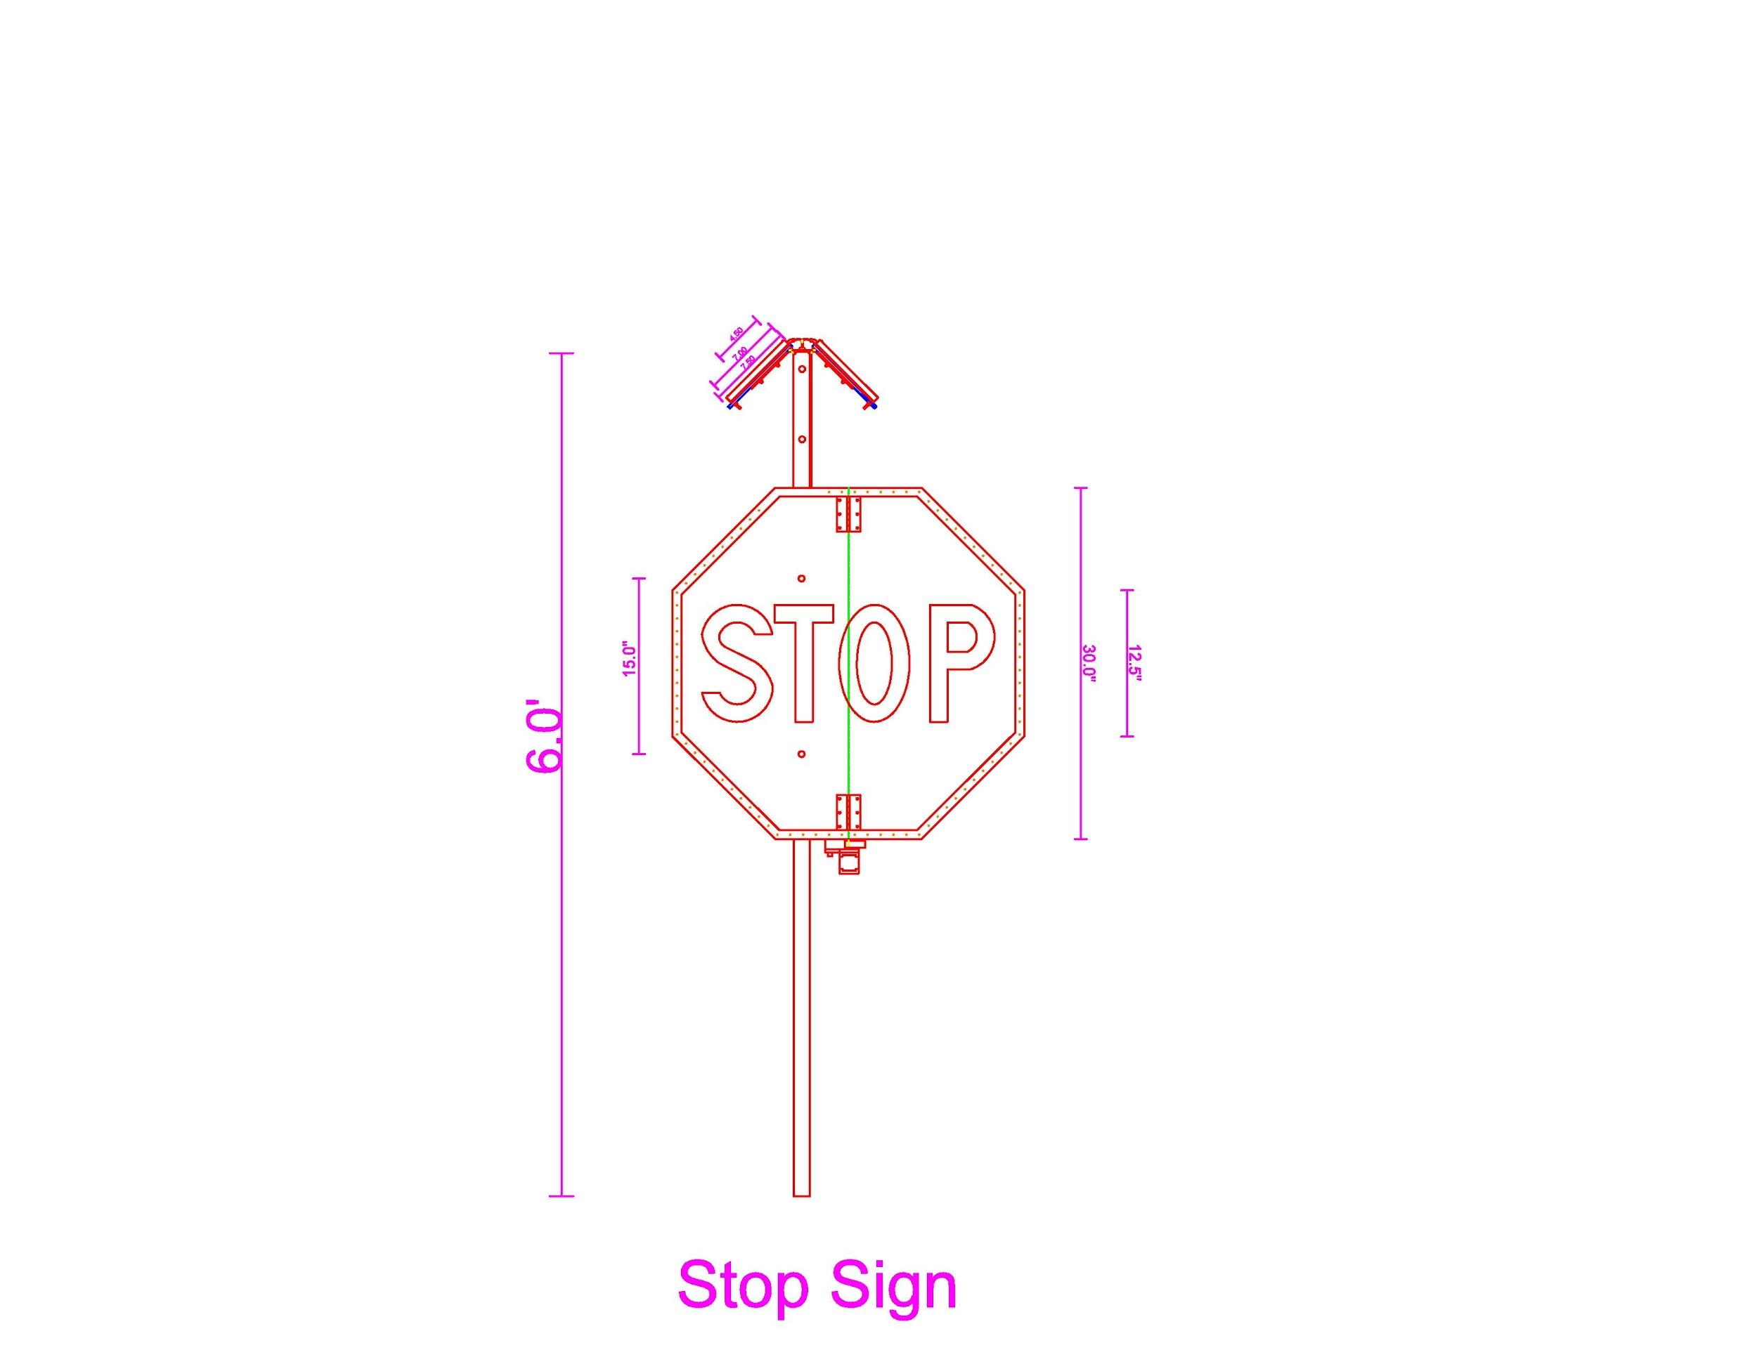

Slide 15
Coding Example
if(Serial.available() > 0) // if the Bluetooth data is being received
{
state = Serial.read(); // set its value into state
flag = 0; // declared so our Serial doesn't loop
}
if (state = “1”)
{
mystepper.step(1); // steps 1.8 degrees while 1 is being received
}

Slide 16
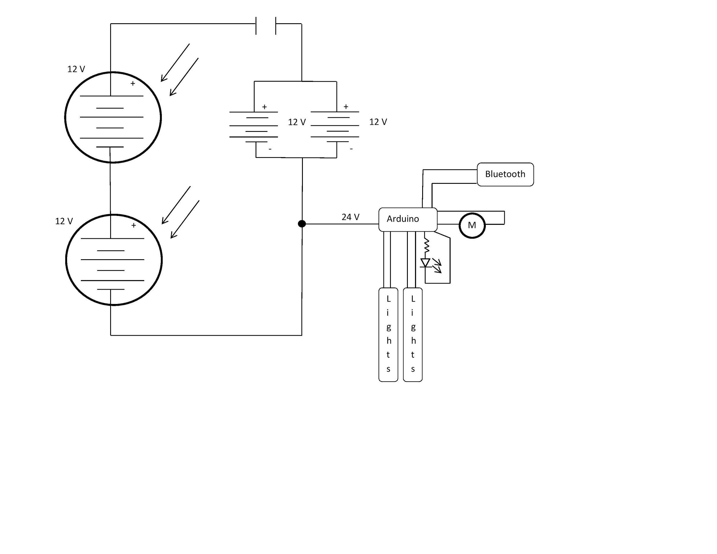

Slide 17

Uses
Implementation
Power Outages at Intersections
Special Events/ Intersections of Churches
School Zones
Substitute for Normal Sign

Slide 18

Successes/Goals Achieved
Motorized Opening/Closing of Sign
Bluetooth Functionality
Protective Casing
Polycarbonate
Security and Durability
Brighter Lights
Higher Lumen Count
Precise Design/Reproduction Capabilities

Slide 19
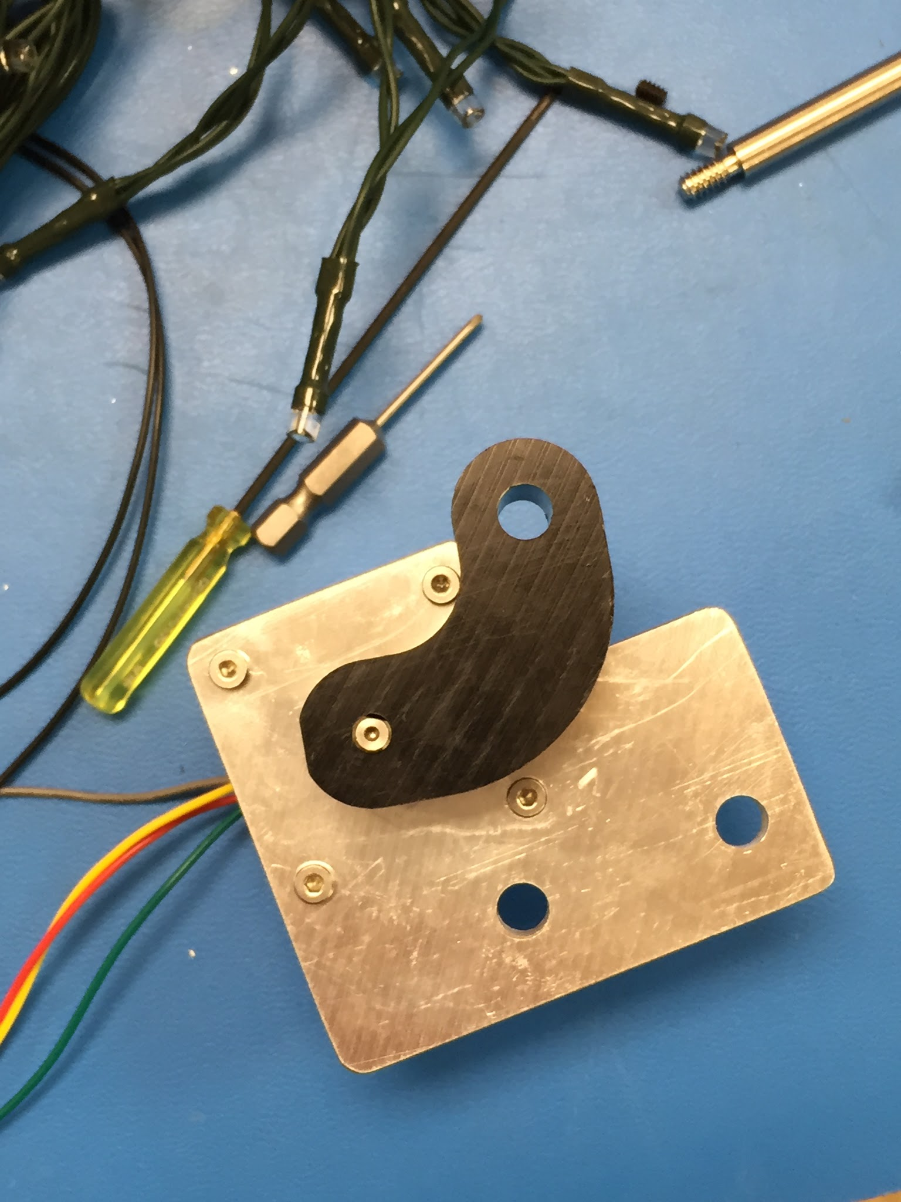
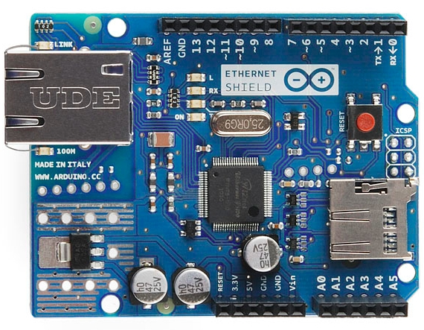
Future Improvements
Communication Improvements
Signal sent from central township headquarters
$200+
Arduino Ethernet Shield & 100’ Cat5e Cable - $125.99
Arduino SIM Card Shield - $39.99 + Monthly Fees
Connect with power grid to sense power outages $359
SainSmart 4-Channel Relay Module - $16.99
Wall-Brick 9v Circuit w/ installation - $225.00
Notes:
Regional
Retractable motor that opens and closes the sign - $356.94
Wireless improvements
Signal sent from car - within range of sign - $99.95
Signal sent out from central township headquarters - $200+
Sign senses power outage itself
Security
To prevent theft of solar panel, lights, or batteries.
Casing - Acrylic 72” x 72” - $23.16
Expand lighting system to other types of signs
Retractable motor that opens and closes the sign - $356.94
Wireless improvements
Signal sent from car - within range of sign - $99.95
Signal sent out from central township headquarters - $200+
Sign senses power outage itself
Security
To prevent theft of solar panel, lights, or batteries.
Casing - Acrylic 72” x 72” - $23.16
Expand lighting system to other types of signs

Slide 20
Future Improvement (cont.)
Expand lighting system to other types of signs
Yield, Speed Limit, Street Signs, etc.
Retrofitting current Stop Signs with a lighting system
Pre-built frame
Clip on to border of sign
Efficient and cost effective

Slide 21

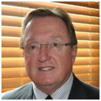
Business Partnerships
Downingtown Engineering Consultants, Inc.
David A. Weightman, P.E.
STEM = collaboration and outsourcing.
Example:
Many DEC projects involve outsourcing to companies such as CAD operators.
On large projects, a variety of engineering types collaborate for success.

Slide 22
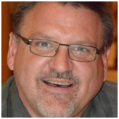

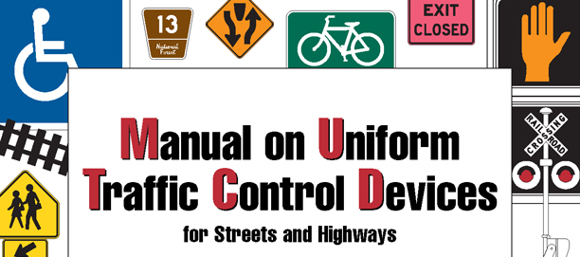
Business Partnership (cont.)
Dean Kaiser: Traffic Engineer
Codes and Regulations for Street Signs

Slide 23
Section 2A.07: Retroreflectivity and Illumination
Light Emitting Diode (LED) units may be used individually within the legend or symbol of a sign and in the border of a sign, except for changeable message signs, to improve the conspicuity, increase the legibility of sign legends and borders, or provide a changeable message.
If used, the LEDs shall have a maximum diameter of 1/4 inch and shall be the following colors based on the type of sign:
White or red, if used with STOP or YIELD signs.

Slide 24
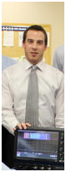

Business Partnerships (cont.)
Communications Test Design Inc. (CTDI)
Matthew Parsons: Lead Automotive Engineer
John Goldman: Engineer
Bill Keegan: Engineer
Different disciplines of engineering overlap
Electrical Engineers collaborate with mechanical engineers (moving and powering our sign).
Assisted with the Build Phase and supplies
Great resource of knowledge

Slide 25
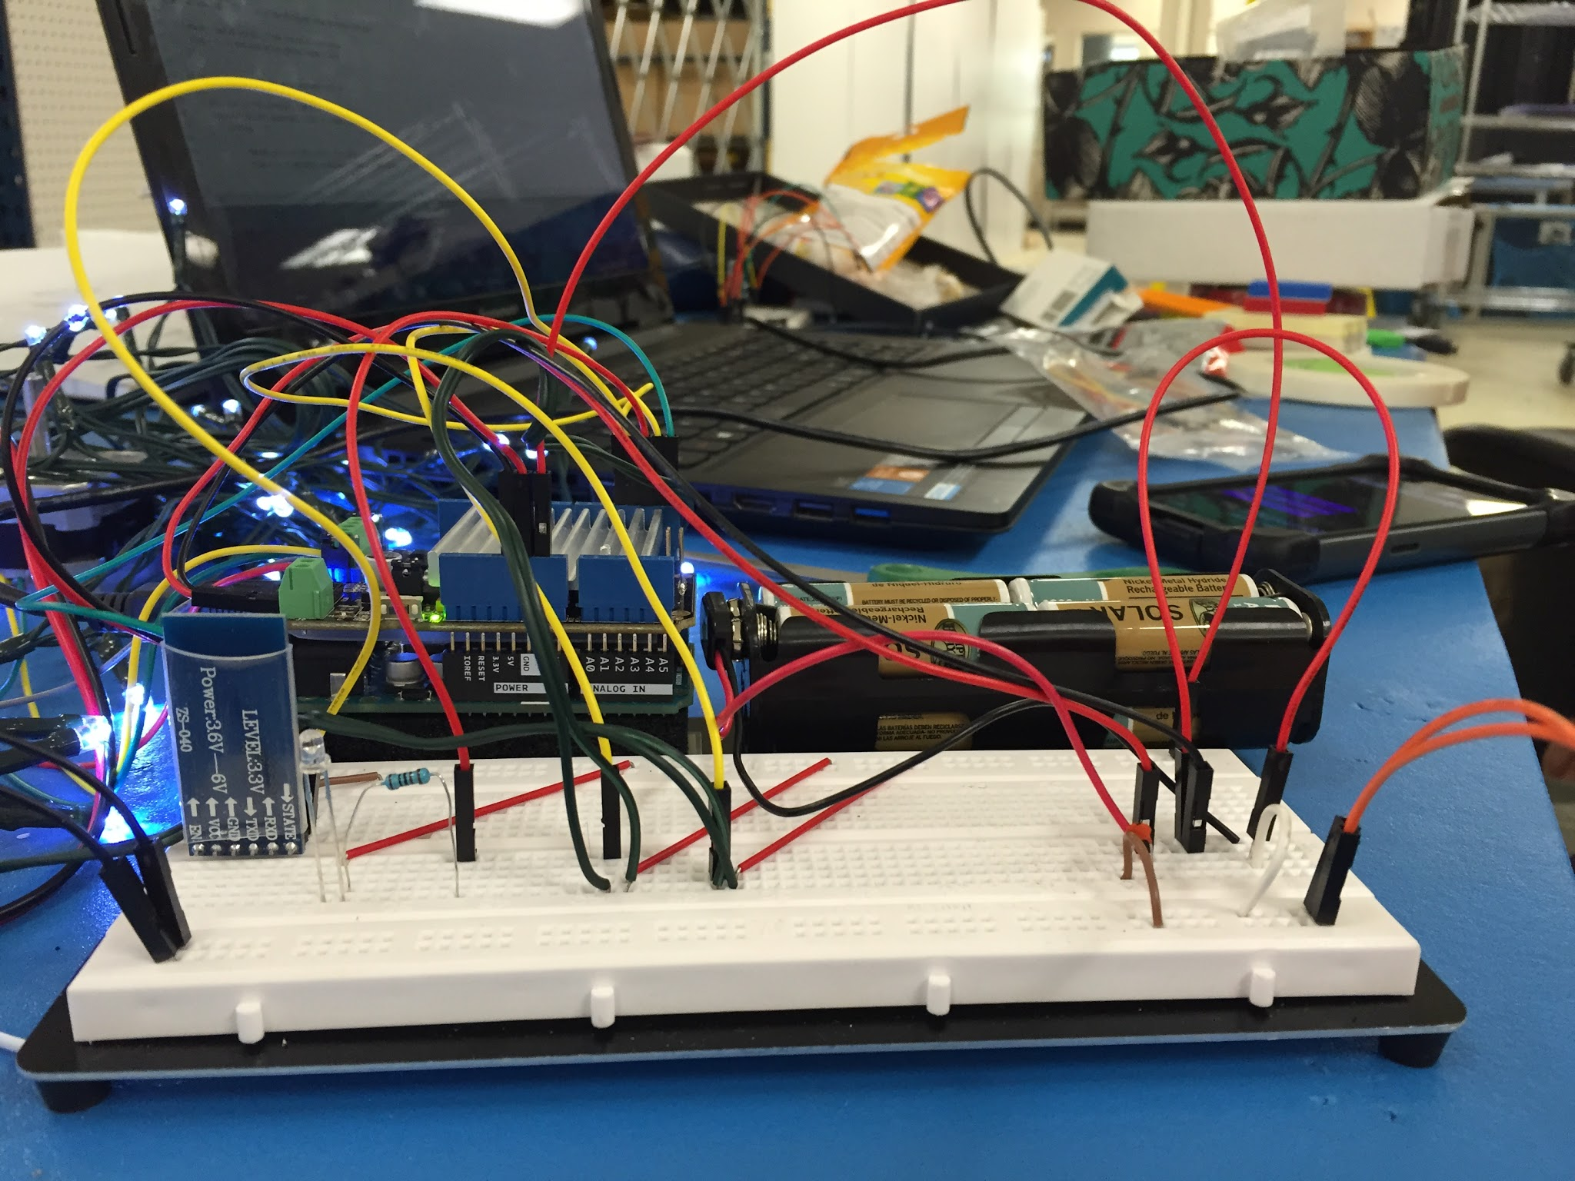
STEM Skills Utilized
Skills We Implemented
Electrical
Computer Programming
Mechanical
AutoCAD
Learning Experience
Notes:
We need to identify 4 STEM related skills and processes to develop and improve the sign.

Slide 26
Team Reflections
Strengths
Andrew - Group Organization/ Research/Application
Angela - Electrical Engineer/ Circuit Design/ DEC Partnership
Conor - Engineering Principles/ CAD Design/ Burns Group Partnership
Matt - Leadership/ Programmer/ Real World Application/ CTDI Partnership
Steve - Presentation Style/ Problem Solving/Design
Notes:
Regional Reflections
Andrew - science/tech research/application and group organization
Angela- engineering and business partnership/research
Conor- Engineering Principles -calculaions/implementation
Matt- Leadership and real world application
Steve- Presentation Style and Problem Solving/Desgin

Slide 27

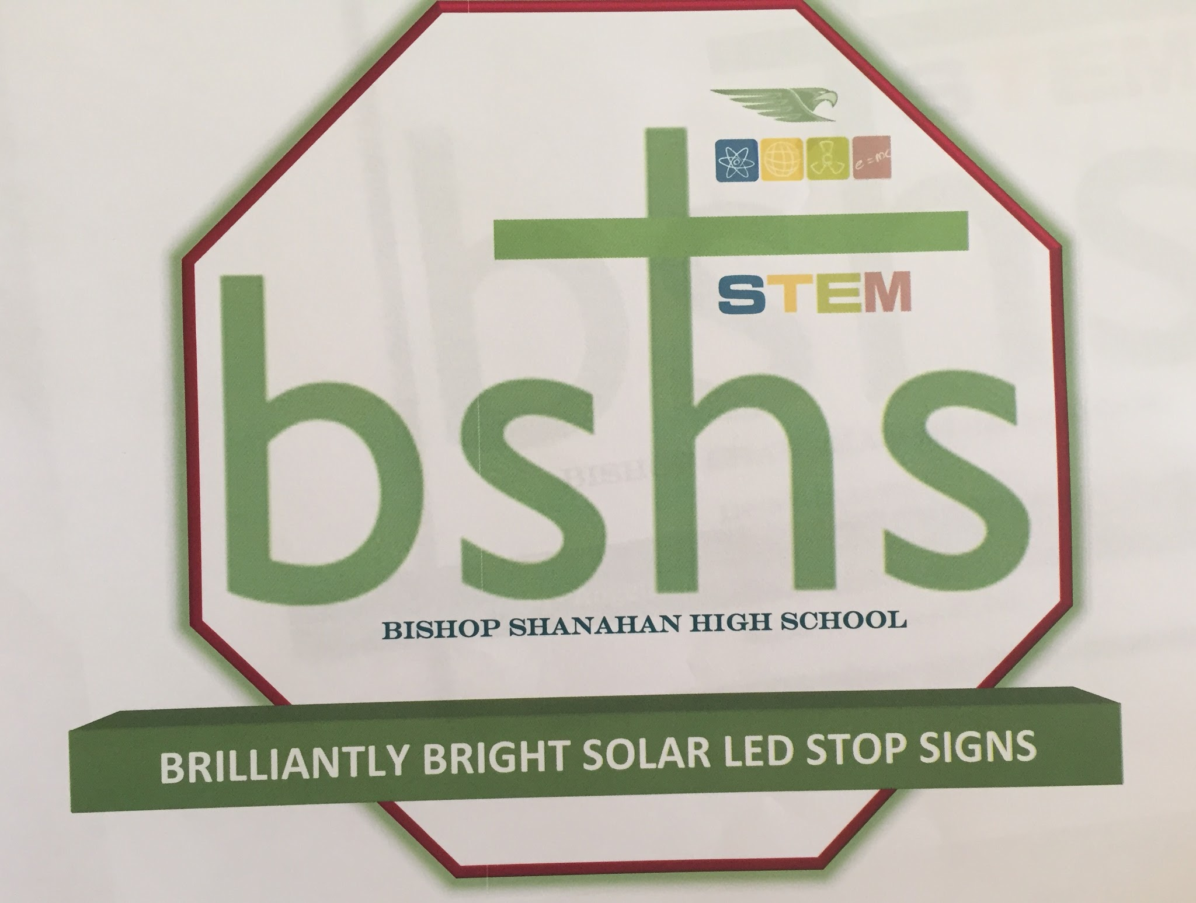
The Mission
Opening eyes of Pennsylvania drivers
Effective and cost-efficient
Energy-efficient
Keep people safe - Save lives

Slide 28
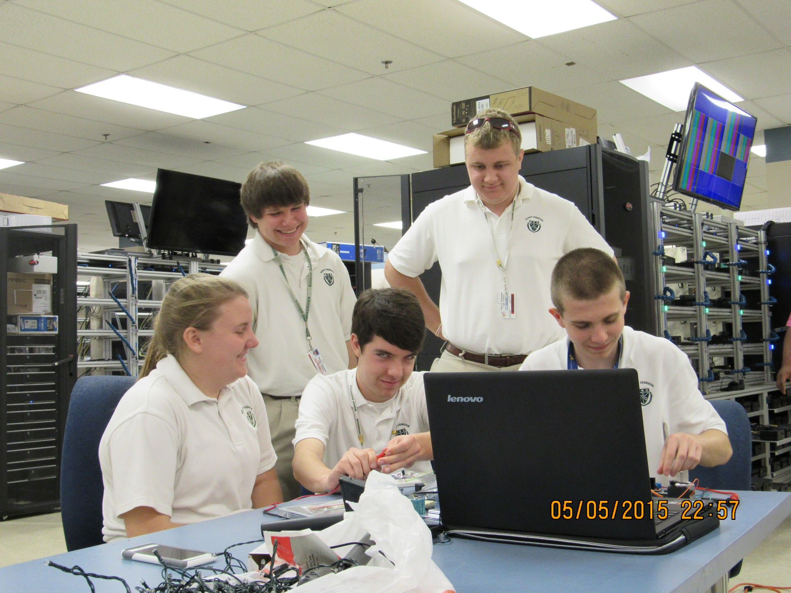
Thank You for Your Time!

